Slide 1
Stacks
Lesson 3

Slide 2
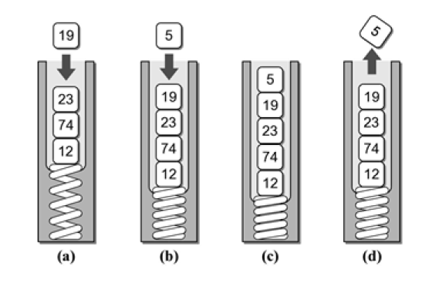
Stacks
A restricted access container that stores a linear collection.
Very common for solving problems in computer science.
Provides a last-in first-out (LIFO) protocol.

Slide 3
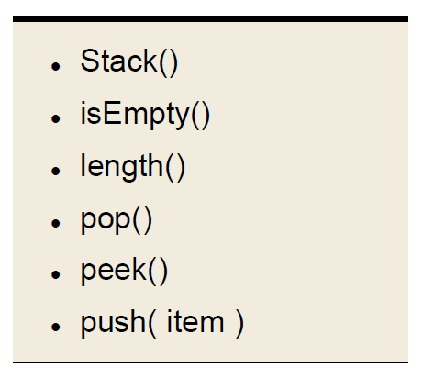
The Stack ADT
A stack stores a linear collection of items with access limited to a last-in first-out order.
Adding and removing items is restricted to the top of the stack.

Slide 4
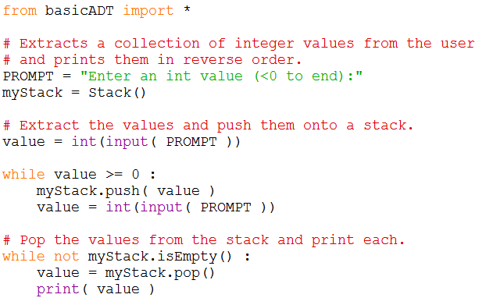
Stack Application Example
reverseNumbers.py

Slide 5
Stack Implementation
Several common ways to implement a stack:
Python list
easiest to implement
Linked list
better choice when a large number of push and pop
operations are performed.

Slide 6
Stack: Using Python list
How is the data organized within the Python list
Most efficient is to let the end of the list represent the top of the stack
Why would the reverse organization not be as efficient?

Slide 7
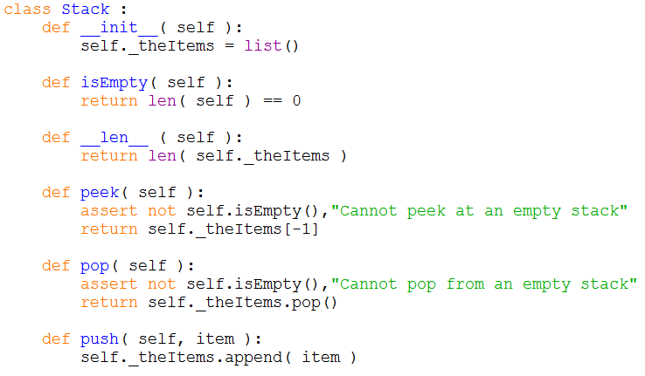
Stack: Python List Implementation
arrayStack.py

Slide 8
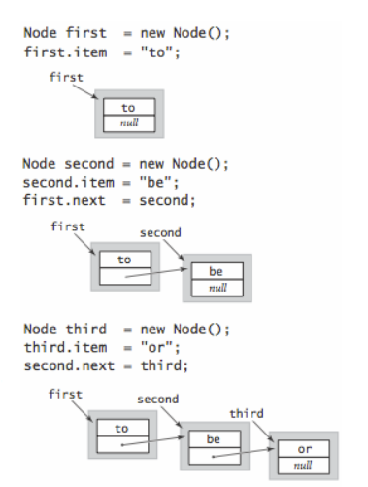

Slide 9
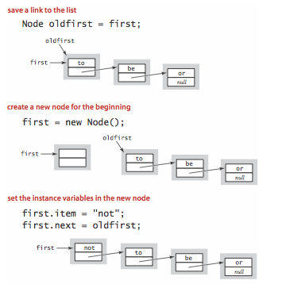
PUSH

Slide 10
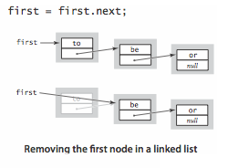
POP

Slide 11
Stack: Linked List
How should the data be organized?
Let the head of the list represent the top of the stack.
None
>>> s = Stack()
top
>>> s.push(5)
>>> s.push(7)
1
>>> out = s.pop()
size
2
0
1
5
7
node

Slide 12
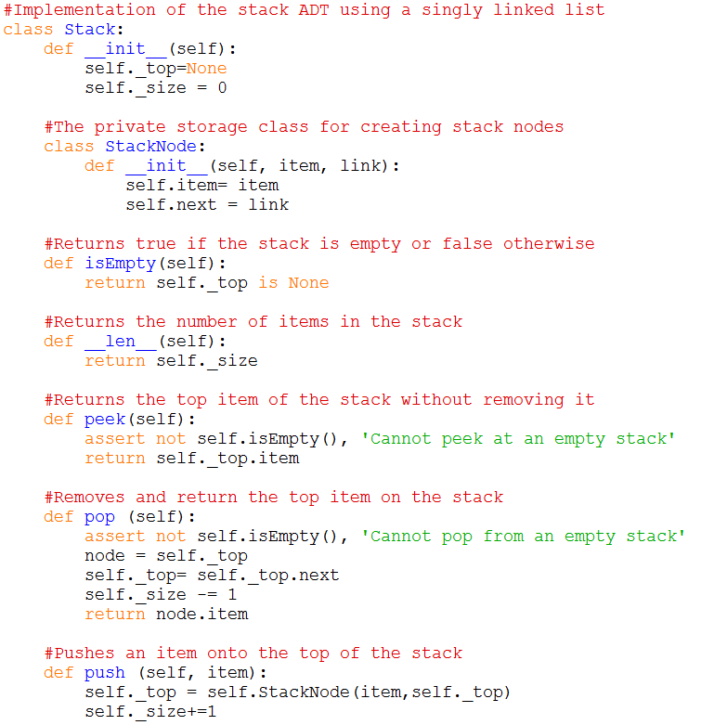
STACK : LINKED LIST

Slide 13
Stack Applications
Many applications encountered in Computer Science requires the use of a stack.
Balanced delimiters
Postfix expressions

Slide 14
Balanced Delimiters
Many applications use delimiters to group strings of text or simple data into subparts.
Mathematical expressions
Programming languages
HTML markup

Slide 15
Source code example
Consider the following C++ source code:
int sumList( int theList[], int size )
{
int sum = 0;
int i = 0;
while( i < size ) {
sum += theList[ i ];
i += 1;
}
return sum;
}
The delimiters must be paired and balanced
We can design and implement an algorithm to
Scan a C++ source file, and
Determine if the delimiters are properly paired

Slide 16
Valid C++ Source?
Practice

Slide 17
Mathematical Expressions
We work with mathematical expressions on a regular basis
Easy to determine the order of evaluation
Easy to calculate
But the task is more difficult in computer programs
A program cannot visualize the expression to determine the order of evaluation
Must examine one token at a time

Slide 18
Types of Expressions
Three different notation can be used
Infix: A + B * C
Prefix: + A * B C
Postfix: A B C * +

Slide 19
Infix to Postfix
Infix expressions can be easily converted by hand to postfix notation
A * B + C / D
Fully parenthesize the expression
((A * B) + (C / D))
For each set of (), move operator to the end of the closing parenthesis
((A B *) (C D /) +)

Slide 20
Infix to Postfix (contd)
The expression at the end of step 2:
((A B *) (C D / ) + )
3. Remove all the parentheses
A B * C D / +
Which results in the postfix version

Slide 21
Evaluating Postfix Expressions
We can evaluate a valid postfix expression using a stack structure
For each token
If the current token is an operand, push its value onto the stack
If the current token is an operator:
Pop the top two operands off the stack
Perform the operation (top value is the RHS operand)
Push the result of the operation back on the stack
The final result will be the last value on the stack

Slide 22
Postfix Evaluation Examples
To illustrate the use of the algorithm, assume
The existence of an empty stack, and
The following variable assignments
A = 8 C = 3
B = 2 D = 4
Evaluate the valid expression
A B C + * D /

Slide 23
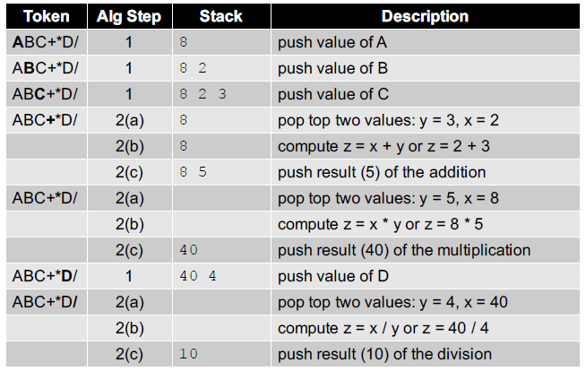
Postfix Example 1

Slide 24
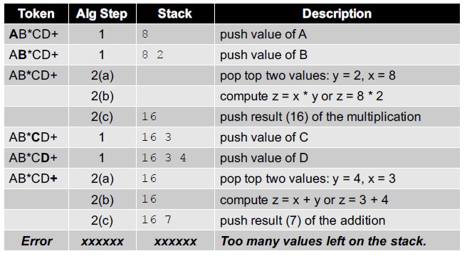
Postfix Example 2
What happens if the expression is invalid?

Slide 25
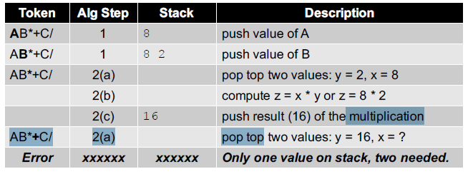
Postfix Example #3
What happens if there are too many operators for the given number of operands?

Slide 26
Main Distinction between 2 implementations
Linked List
Dynamic number of items
Array
Fixed size? How do we resize to accommodate more elements?
Half Problem Set 2 weeks ago.

Slide 27
Performance of implementation
Tradeoffs.
Can implement a stack with either resizing array or linked list; client can use interchangeably. Which one is better?
Linked-list implementation.
Every operation takes constant time in the worst case.
Uses extra time and space to deal with the links.
Resizing-array implementation.
Every operation takes constant amortized time. Why?
Less wasted space.

Slide 28
Scenarios
Which ADT implementation will you use?
Time-critical situation
Memory critical situation

